Slide 1
Worker’s Compensation Analysis
Jagadish Ballur Ravi
Pooja Sharma
Manasa Puli
Yagnesh Vadalia
Diptesh Nath

Slide 2
PROJECT OBJECTIVE
Using predictive modelling techniques help to reduce claim cost for the company.

Slide 3
A RECAP
Earlier performed Exploratory Data Analysis on Workers Compensation Data for a claims’ company.
Highlights from the Visualizations
1. Claim costs varied drastically depending on injury nature of claims. Eg: Strain
2. Claim costs differed based on age groups of the claimants.
3. Certain injury nature and Body part had more frequent occurrences.

Slide 4
Data Preparation for Modelling
Claim records after year 2000. - Faster processing and more recent results.
New Variable creation:
IncidentWeekday - Extracted from the Incident date.
DaysToClosure - Days elapsed between the time the incident was reported and closed.
RiskClass - Using k means clustering.
We encoded certain categorical variables and removed the original variable.
For example: We encoded gender variable as 0 for male and 1 for female.
We encoded claimant type as 2 for indemnity , 1 for medical.

Slide 5
Classifying Claims
In order to identify high cost claims we classified records into high risk and low risk category.
Used k-means clustering on the total paid costs to achieve the classification.
Certain claims with injury natures like Strain were classified as low risks. However if the company is able to reduce the overall number of cases reported for Strain injury then it will be able to reduce their claim costs significantly.

Slide 6
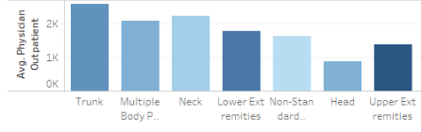
Additional Data Highlights - BodyPart
Additional Transaction costs for claims varied based on the body part region.
1. Average cost in Trunk was highest.
2. Upper Extremities had the highest number of casualties but the average cost was almost half of that of Trunk casualties.
3. Below is a chart for the average physician outpatient costs and body part region.

Slide 7
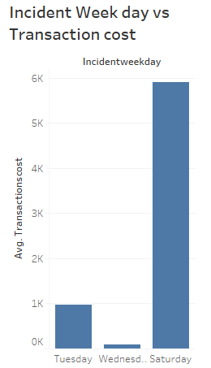
Additional Data Highlights - IncidentWeekday
Many injuries did not occur throughout the week.
For example - If we look at all claims with freezing injury
nature and the weekdays on which such incidents
occurred it was not distributed throughout the week.

Slide 8
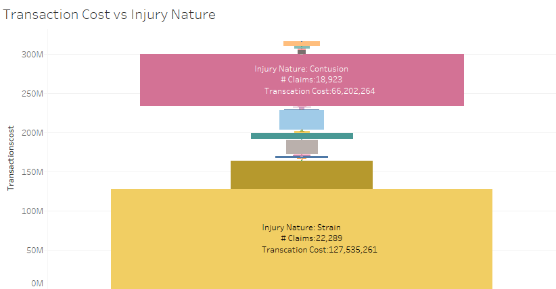
Additional Data Highlights - Injury Nature

Slide 9
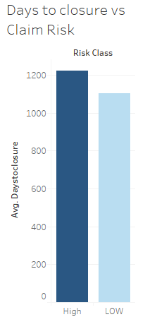
Additional Data Highlights - DaysToClosure
High risk claims had higher days to closure and higher costs.
Low risk claims had lower days to closure and comparatively
lower costs.

Slide 10
Modelling Techniques
Linear Regression:
Dependent Variable : Total Claims Costs
Independent Variable: Days to closure and claimant age
Results: Achieved an R-squared value 12%.
Limitations: Since linear regression works best with continuous variables and we did not enough continuous variables, the results were not highly accurate.
The assumptions required for linear modelling were not fully satisfied except that the age variable was normally distributed.
Also a lot claims were closed in 2005, which gave skewed distribution for days to closure.

Slide 11
Modelling Techniques
Logistic Regression
Dependent Variable : Risk Category - High or Low
Independent Variables :
Gender BodyPartRegion
Injury Type DaysToClosure
Claimant Type UpperWageLimit
UpperAgeLimit

Slide 12
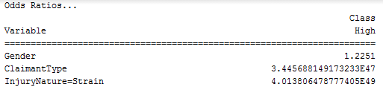

Modelling Techniques
Odds Ratio from Logistic Regression

Slide 13
Predictive Modelling - Decision Tree C5.0/C4.5
C4.5 Algorithm produces a tree of more variable shape.
Why we chose C4.5 :
In Claim records certain variable combinations determined the claim costs and most of the variables were categorical.
For categorical variables, C4.5 by default produces a separate branch for each value of the categorical attribute and works on the concept of information gain.
Variables Used: We used all the variables from logistic regression except injury nature.

Slide 14
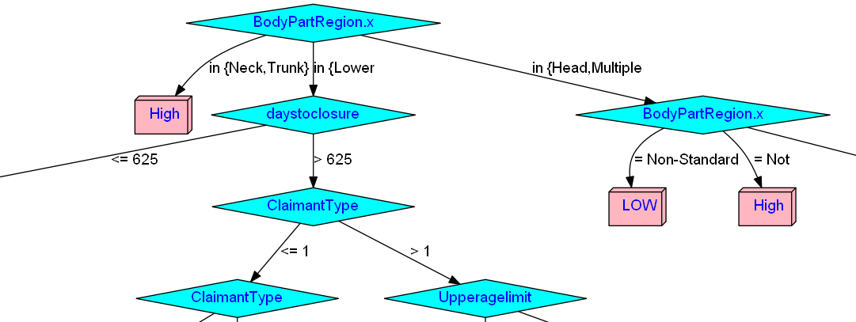
Predictive Modelling - Decision Tree C5.0/C4.5
Partial Image of the Decision Tree
The model was able to identify splits based body part region, days to closure , claim type and age group of claimants.

Slide 15
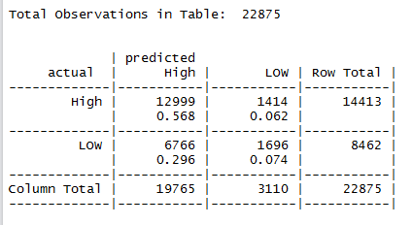
Predictive Modelling - Decision Tree C5.0/C4.5
Predictive Modelling Results:
Using the C5.0 model we were able to achieve an accuracy of 65% .

Slide 16
Key Findings…
Root node of our decision tree was split using body part region , into 3 categories namely {neck , Trunk}, { Lower }, { Head, Multiple and other}
If injury occurs in neck or trunk the claims are more likely to be high , out of 11533, 9311 tends to be higher risk claims
The next major splits that occur throughout the plot is days to closure. If it is more than 6245 days majority of the 70% claims turns out to be High risk claims.
When the number of days to process the claim are less than 625, then upper wage limit turns out to be a crucial factor. If upper wage is less than $1000, then majority of the claims turns out to be higher risk one.

Slide 17
Thank You….

